Slide 1
Hit video games: Data Mining & Machine Learning​
By: Tomer Yaish, Dan Kvitca

Slide 2
Research Question​
Our definition of hit: A video game that sold more than 1 million copies world wide.
Can we predict if a video game will be a hit?​
Prediction
Definition

Slide 3
Data Source/Refrences
MetaCritic
Metacritic is a website that aggregates reviews of films, TV shows, music albums and video games.
link
1
PriceCharting
3
PriceCharting is a source for current and historic prices on video games.
link
VgChartz
2
VGChartz delivers comprehensive game chart coverage, including sales data, news, reviews, & game database for all platforms.
link

Slide 4
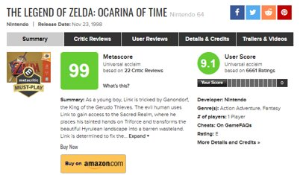
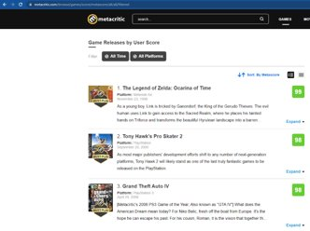
MetaCritic
A
All games we've used wore taken from this list
B
Data used for each game :
MetaCritic Rating, Release date, User Rating, Publisher, Platform,Developer,Number of Players,Age Appropriate

Slide 5
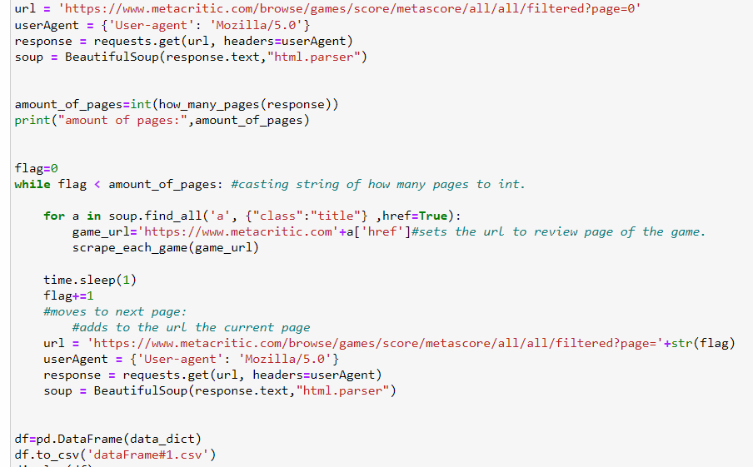
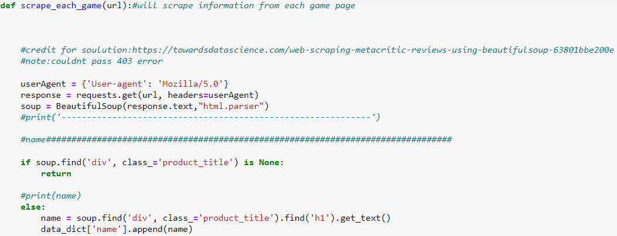
MetaCritic
A
The games list has 191 pages,each page has 100 games
B
​ Each video game: Name,Meta Rating, User Rating, Release Date, Publisher,Developer,Platform,Age Appropriate, Number Of Players

Slide 6
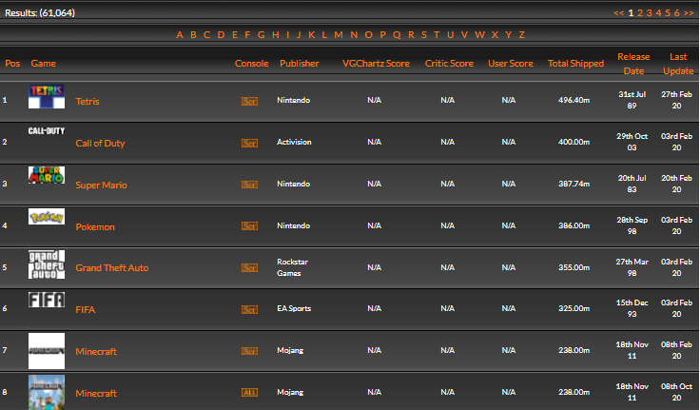
VgChartz
A
B
​ We used VgChartz to add a 'Total sales' column for each game
All games we've used wore taken from our Dataset.

Slide 7
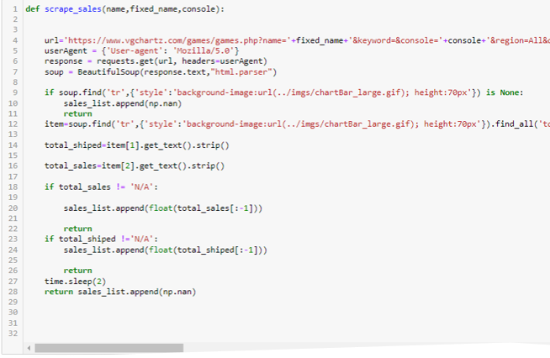
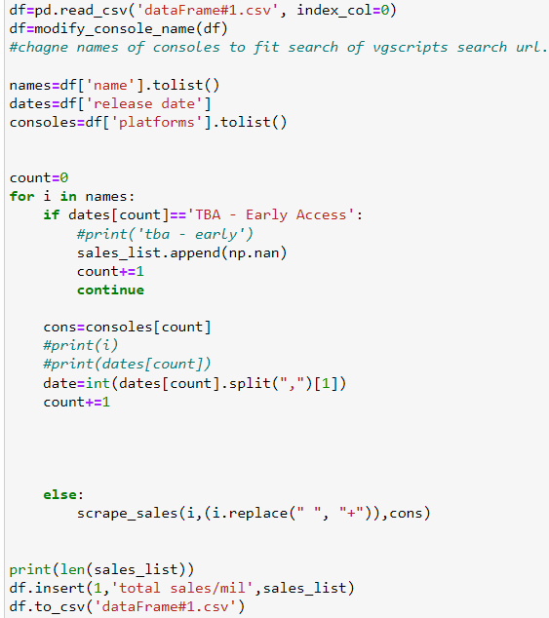
VgChartz
A
All games released before 2006 are skipped​

Slide 8
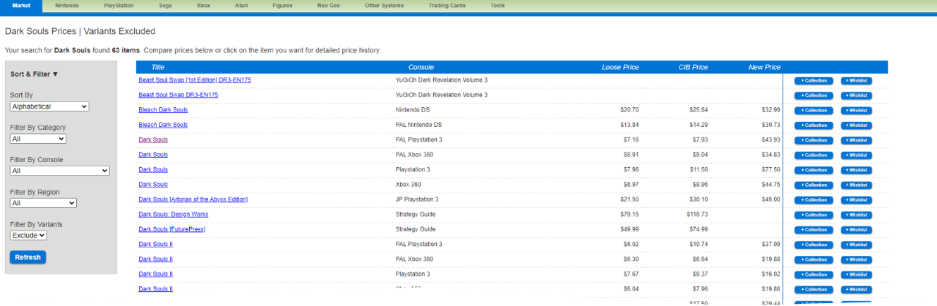
PriceCharting​
A
PriceCharting was used to collect price for each game from our data set

Slide 9
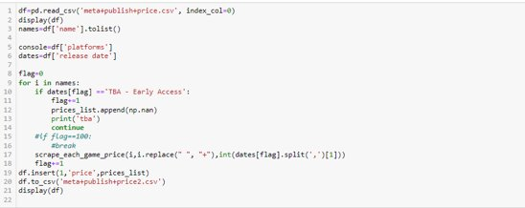
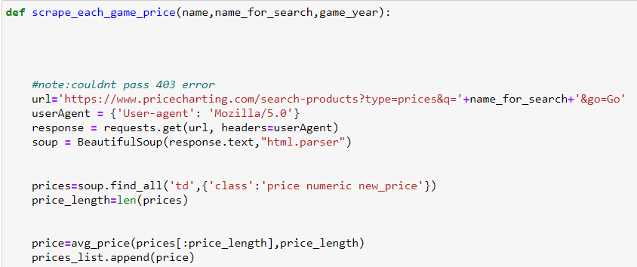
PriceCharting​
A
All games released before 2006 are skipped

Slide 10
Data Manipulation
Cleaning
Duplicates, nan's
LEVEL 1
LEVEL 3
Adding "Hit" column : 1 for a game who sold over 1M copies and 0 for those who didn’t..
Dealing with outliers
LEVEL 2
LEVEL 4
Transforming string column to float (for later use in ML)
And labeling.

Slide 11
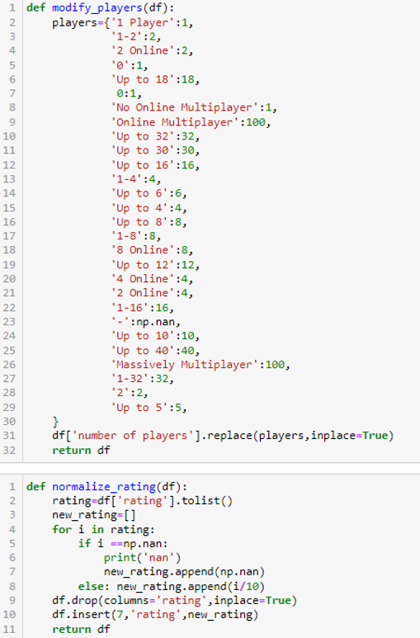
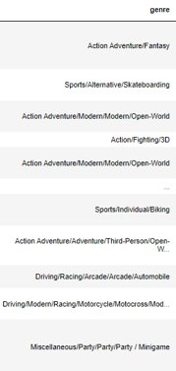
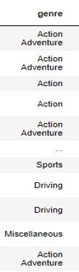
Data Manipulation

Slide 12
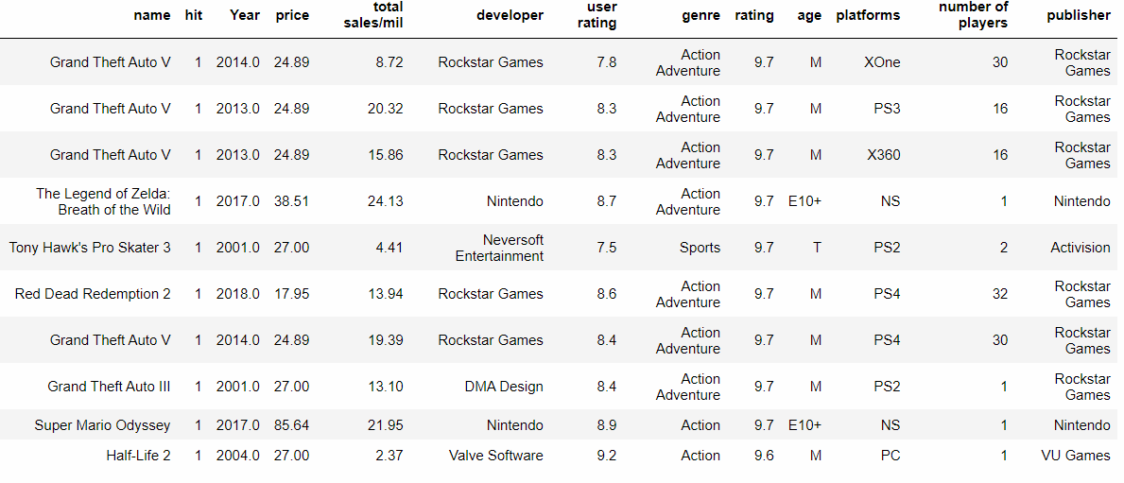
Data Manipulation
Final DataFrame

Slide 13
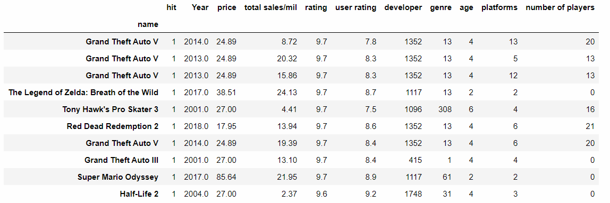
Data Manipulation
Final DataFrame after labeling

Slide 14
visualization

Slide 15
visualization
Visualize
First we wanted to visualize our Data.
Visualize scatter
We visualize a scatter plot that showed us the connection between the sales col and the rating col
Get notes
We wanted to find if there any connections between sales and other parameters

Slide 16
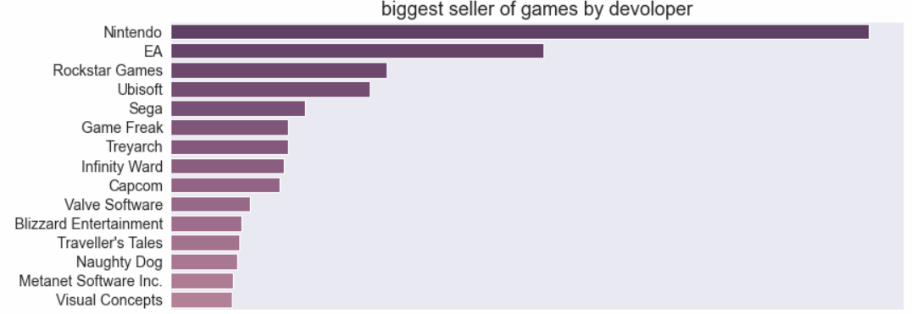
visualization

Slide 17
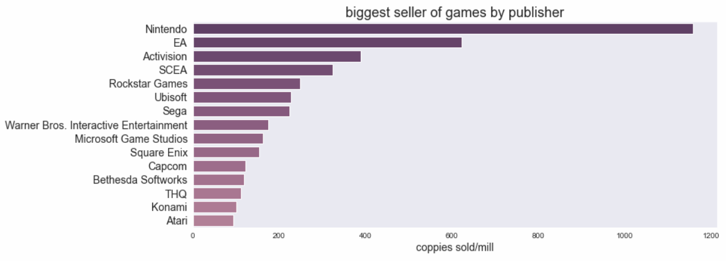
visualization

Slide 18
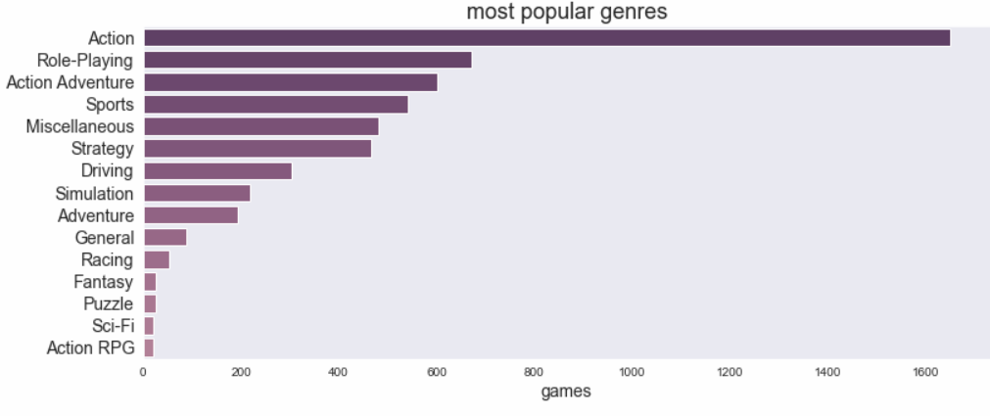
visualization

Slide 19
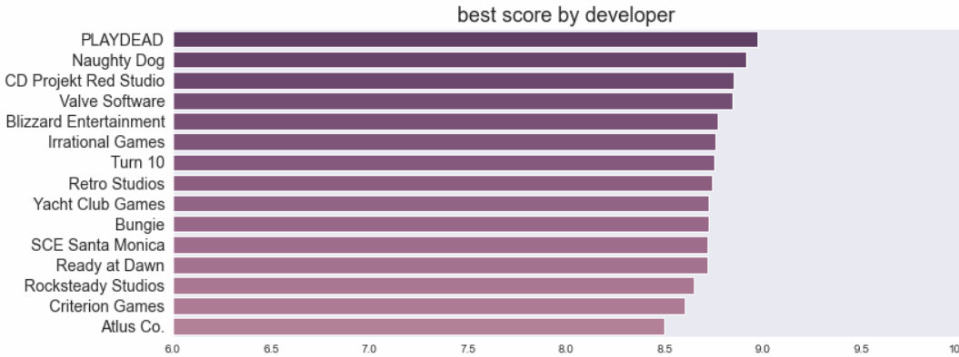
visualization

Slide 20
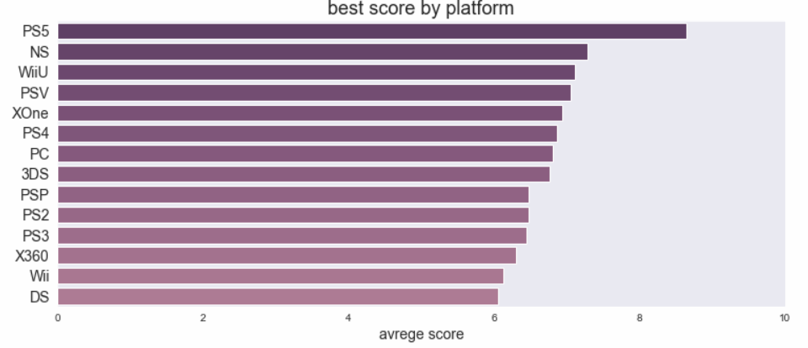
visualization

Slide 21
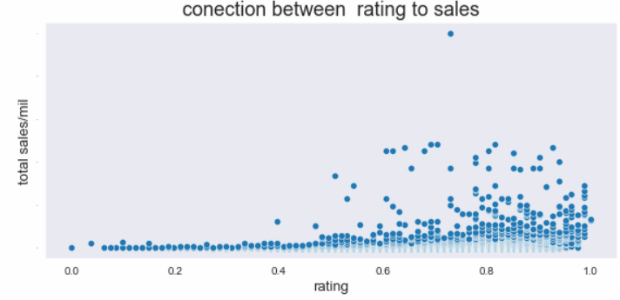
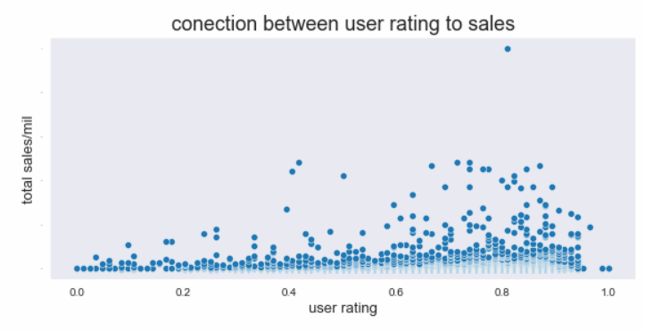
visualization
We susspect for a strong connection between a hit game and its rating.

Slide 22
Machine Learning​
Machine Learning is the final step in our project, and here is how we did it.
1
Labeling a categorical columns
2
Try few algorithms and find out which one gives us the best accuracy score without overfitting.
3
Choose the best algorithm and try to make it even better.

Slide 23
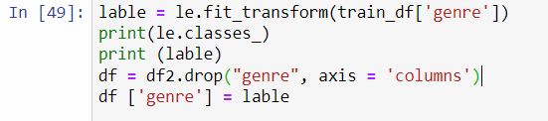
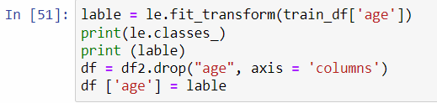
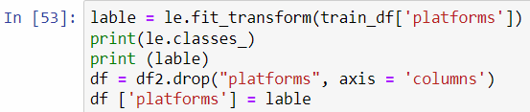
Machine Learning​
1
Labeling a categorical columns.

Slide 24
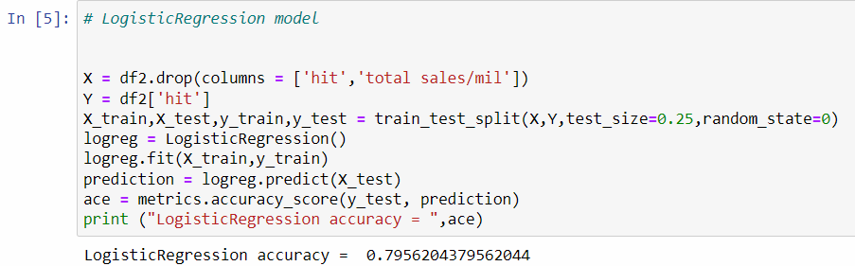
Machine Learning - Choosing a model
​
2
Try few algorithms and find out which one gave us the best accuracy score without overfitting.
Logistic Regression:
Advantages:
doesn't require high computation power, easy to implement, easily interpretable
Disadvantages:
Logistic regression is not able to handle a large number of categorical features/variables. It is vulnerable to overfitting.
Logistic regression will not perform well with independent variables that are not correlated to the target variable and are very similar or correlated to each other.

Slide 25
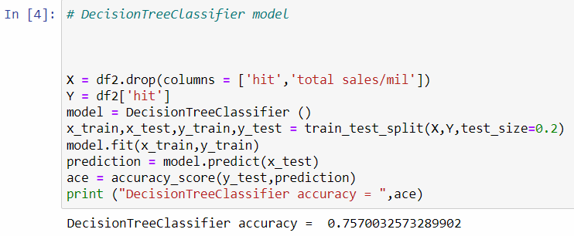
Machine Learning - Choosing a model
​
2
Try few algorithms and find out which one gave us the best accuracy score without overfitting.
Decision Tree:
Advantages:
Compared to other algorithms decision trees requires less effort for data preparation during pre-processing. A decision tree does not require normalization of data.
Disadvantages:
Decision tree training is relatively expensive as the complexity and time has taken are more.
A small change in the data can cause a large change in the structure of the decision tree causing instability.

Slide 26
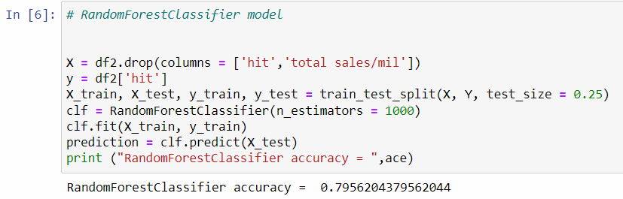
Machine Learning - Choosing a model
​
2
Try few algorithms and find out which one gave us the best accuracy score without overfitting.
RandomForestClassifier :
Advantages:
reduces overfitting in decision trees and helps to improve the accuracy.
works well with both categorical and continuous values.
Normalising of data is not required as it uses a rule-based approach.
Disadvantages:
requires much time for training as it combines a lot of decision trees to determine the class.
requires much computational power.

Slide 27
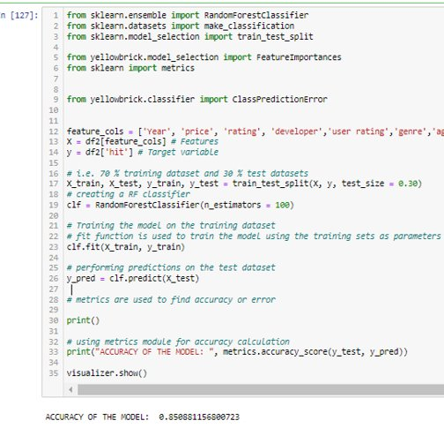
Machine Learning​
RandomForrestClassifier​​
3
Choose the best algorithm and try to make it even better.
The algorithm was chosen after testing it against other models
We manage to get up to 85% accuracy

Slide 28
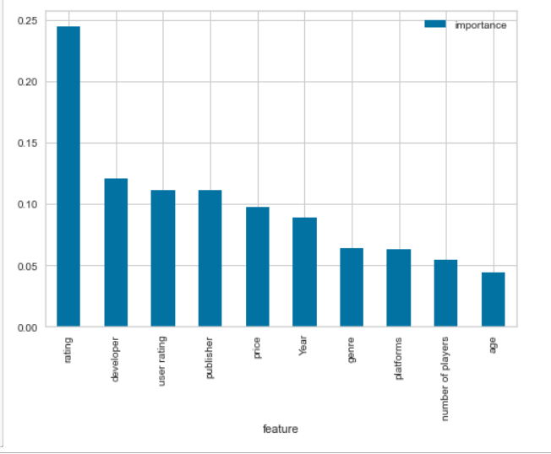
Machine Learning​ - Conclusion
RandomForrestClassifier​​
3
Choose the best algorithm and try to make it even better.
We found a strong connection between
The chances that a game will become a hit,To its rating.

Slide 29
Resources
language:Python 3.9
Developed in Jupyter Notebook
Libraries:
Pandas-used for managing data(DataFrame)
Numpy-general calculations
BeautiulSoup - MetaCritic,PriceCharting,VgChartz crawlers
Seaborn & Matplotlib - visualization
Sklearn - Machine Learning models
YellowBrick library for Sklearn - used for visualization of model and deciding which type of model to use.

